Slide 1
Agentic Workflows
In Business Management

Slide 2
What is agentic Workflow?
A workflow system to give individuals in a team/chain of command autonomy and control over their tasks, decisions, and processes
How is GenAI used in agentic workflow?
GenAI for Routine Decisions: AI handles repetitive or data-driven decisions, freeing human agents to focus on strategic, high-impact work.
Personalized Workflow Solutions: GenAI can customize workflows in real time based on individual performance, team dynamics, or project goals.
AI as a Decision Support Tool: AI models provide suggestions, forecasts, and real-time recommendations that empower employers to act autonomously.
Current Problem?
Difficult to implement using traditional methods such as rule based programming or advanced machine learning.
GenAI changes that as LLMs respond intelligibly to prompts that were not explicit during training.

Slide 3
Agentic Reasoning Design Patterns
 | Reflection | Tool Use | Planning | Multi Agent Reasoning
Pattern Overview | Assess its own actions, processes, and decisions. | Select and apply external tools, resources, or systems to solve specific problems or enhance its own capabilities | Ability of an agent to think ahead, set goals, and devise strategies to achieve those goals. | Involves agents working collaboratively with other agents.
Key Elements | Self-assessment of outcomes Learning from feedback (both positive and negative) Identifying areas for improvement or adjustments | Knowledge of available tools or resources Ability to integrate and interact with tools effectively Decision-making about which tool to use for a specific task | Goal-setting based on objectives Breaking tasks into sub-tasks or steps Anticipating possible outcomes and planning contingencies | Communication between agents (sharing data or knowledge) Coordination of tasks and delegation Ability to negotiate or collaborate toward shared objectives
Use Case | Reflect on how customers responded to its suggestions. If certain recommendations led to hi | Data visualization tool to generate charts or graphs for a presentation. Process large amount of data and provide insights. | AI agent might plan an optimal logistics route by considering traffic data, delivery deadlines, and resource availability. | Multiple AI agents might work with human team members to coordinate tasks, schedule meetings, and update timelines.
Benefits | Enables continuous learning and adaptation, ensuring agents improve their performance over time and make more informed decisions. | Enhances the agent’s problem-solving capacity by allowing it to leverage external resources efficiently, enabling more complex and varied tasks to be handled. | Improves efficiency and foresight, enabling agents to handle complex tasks and adapt to dynamic environments while remaining goal-oriented. | Increases efficiency and problem-solving capabilities by enabling multiple agents to tackle tasks cooperatively, pooling their strengths and information.

Slide 4
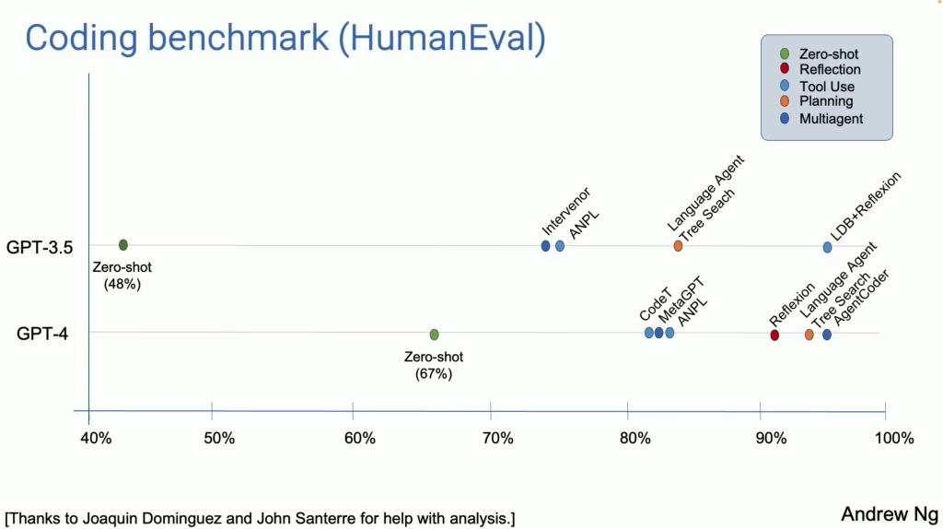
A benchmark to show that AI with agentic workflow is better than zero-shot.

Slide 5
Why is GenAI useful in agentic workflow?
Real time insights
Suggestions and automated solutions
Faster decision making without constant managerial intervention
Automates routine tasks
Why is it useful for senior management?
Reduced workload
Reduced time taken to understand team/project performance

Slide 6
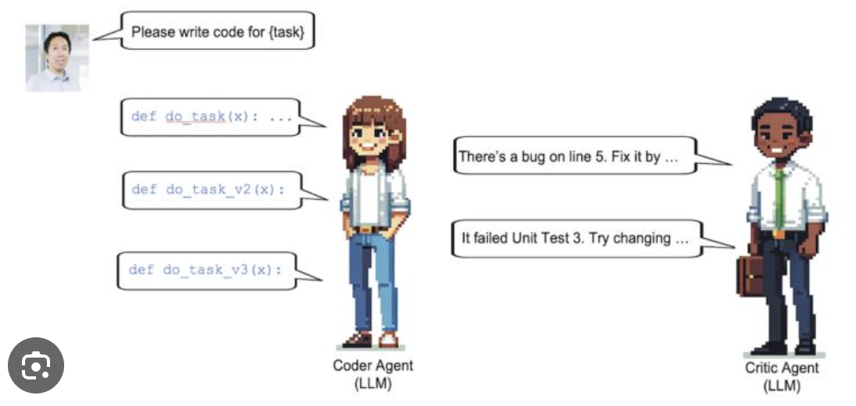
Example of agentic workflow solution
Different AI Agents working together to give a better output than a zero-shot output

Slide 7
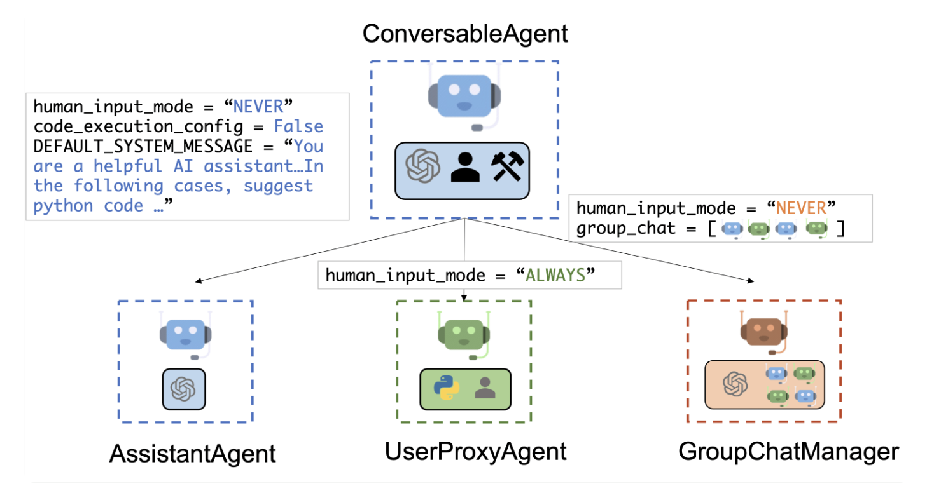
AutoGen Example: Microsoft Framework
https://www.analyticsvidhya.com/blog/2024/07/microsofts-autogen-framework-for-agentic-workflow/

Slide 8
Our Solution: Chatbot
Agents we might need:
Input Processing Agent (linked to Chatbot Agent)
Chatbot Agent
Work Tool Connecting Agent
ML Agent (to process forecasting, insights)
Code Compiling Agent
Output Agent

